Slide 1
What is “rule of law backsliding”?
The process through which
elected public authorities deliberately implement governmental blueprints which
aim to systematically weaken, annihilate or capture internal checks on power with
the view of dismantling the liberal democratic state and entrenching the long-term rule of the dominant party
Pech and Scheppele, ‘Illiberalism Within: Rule of Law Backsliding in the EU’
Cambridge Yearbook of European Legal Studies (2017)

Slide 2
Constitutional capture process in a few steps
Starting point: significant number of citizens losing faith in system of government
2nd step: Disgruntled citizens vote to break the system by electing a leader who promises radical change, often referring to the ‘will of the people’ while attacking the pre-existing constitutional framework
3rd step: new autocrats act quickly to capture/shut down the key offices that might resist consolidation of power
4rd step: autocrats engage in benefit giveaways while seeking to control the public debate and eliminating alternative views
5th step: change election law/framework + vote suppression
If re-elected = democratic game over

Slide 3
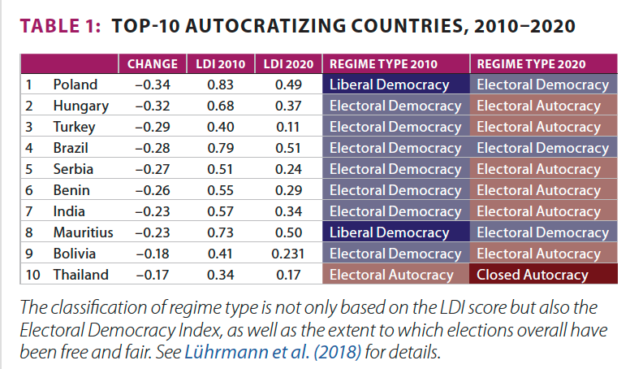

Slide 4
“We are seeing mounting evidence of a process of rule of law backsliding gaining momentum in the UK with irresponsible legislation such as the Internal Market Bill accompanying irresponsible rhetoric and recurrent attacks on the legal profession. This seriously damages the UK’s reputation as a law-abiding country. […] Coupled with ongoing calls to abolish or revamp the Electoral Commission, it is difficult not to think that the UK is following in the footsteps of Viktor Orban’s Hungary and Jaroslaw Kaczynski’ Poland. I hope I will be proven wrong.”
Source: “UK could follow Hungary and Poland in ‘backsliding’ on rule of law, December 2020: https://www.irishlegal.com/articles/uk-could-follow-hungary-and-poland-in-backsliding-on-rule-of-law

