Slide 1
Attitudes towards migration
And FoM
Richard Bentall
May 2023

Slide 2
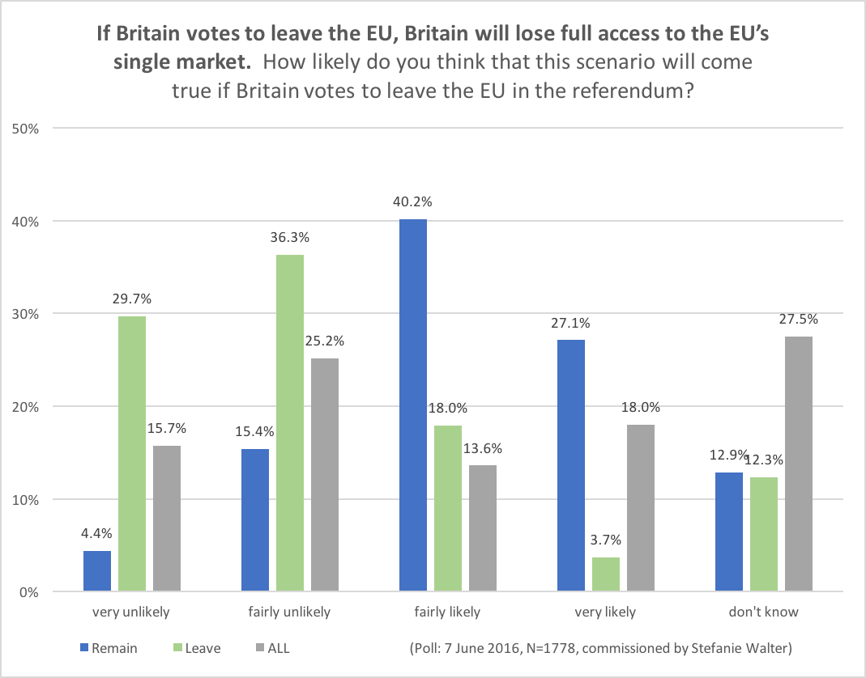
Hard Brexit has never been supported
Polls at the time of the 2016 referendum showed that most people expected the UK to stay inside the EU single market.
Interestingly, leave voters (66% fairly or very unlikely) expected this more than remain voters (19.8%).

Slide 3
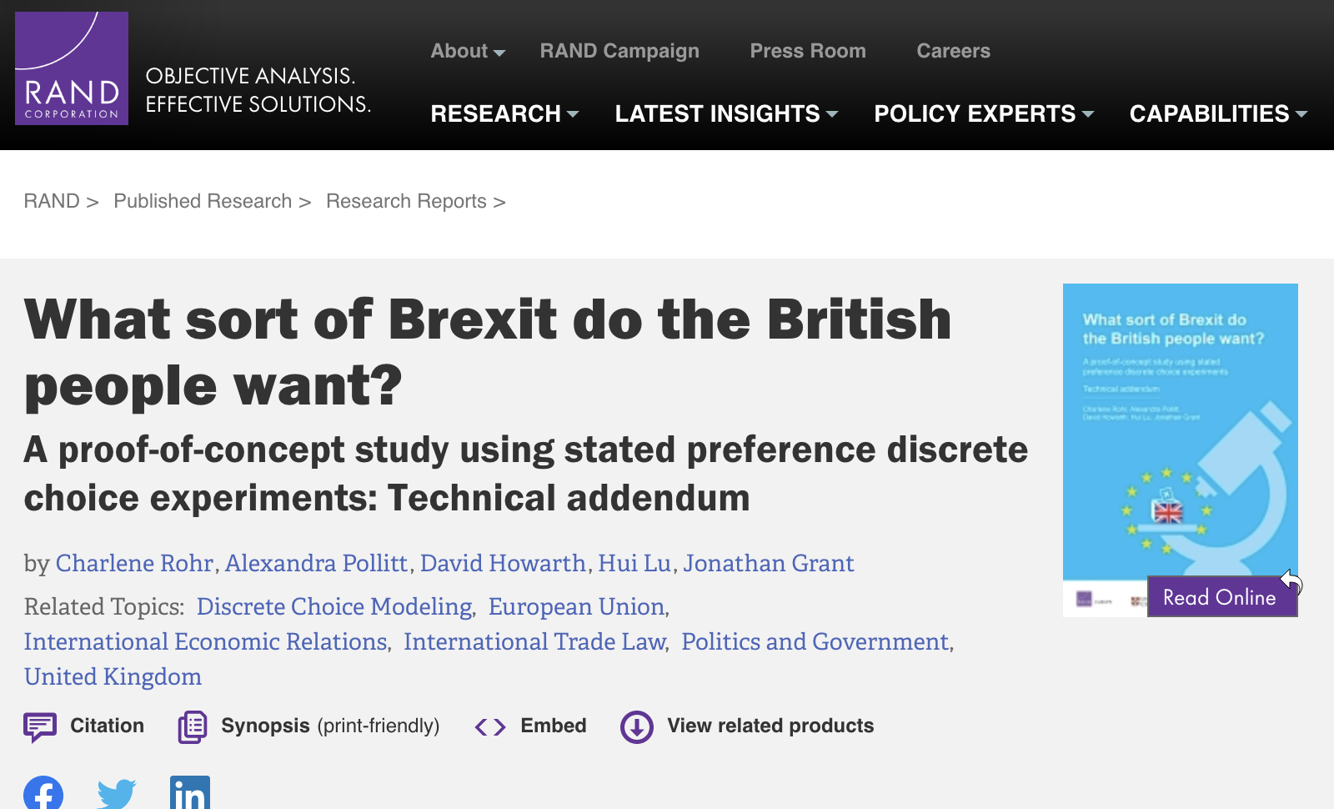
Hard Brexit has never been supported
In 2017, RAND Europe carried out a discrete choice experiment to probe the nuances of British Brexit attitudes.
Greater value placed on ability to make trade deals and access to the Single Market, than for restricting freedom of movement, increased sovereignty and reduced EU contribution.
More concern with restricting demand for public services than simply restricting freedom of movement, particularly those who voted to leave the EU.

Slide 4
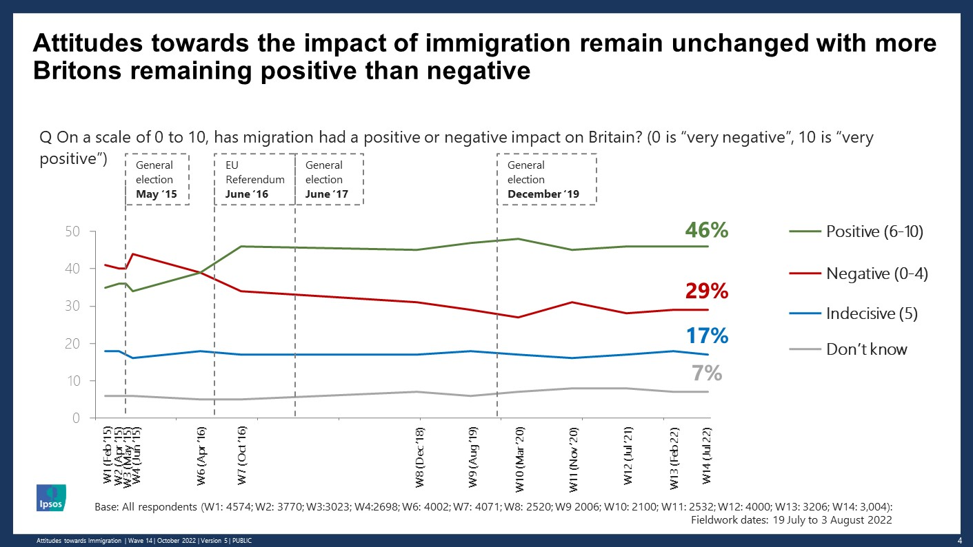
There has been a sharp shift in attitudes towards migration over the last 3 years.

Slide 5
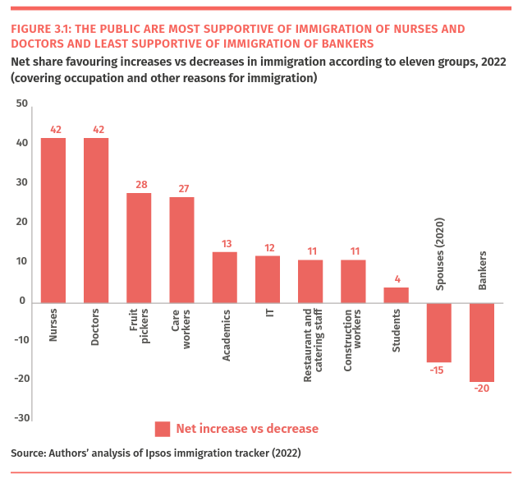
There has been a sharp shift in attitudes towards migration over the last 3 years.
From Ford and Morriss (2022): Institute for Public Policy Research

Slide 6
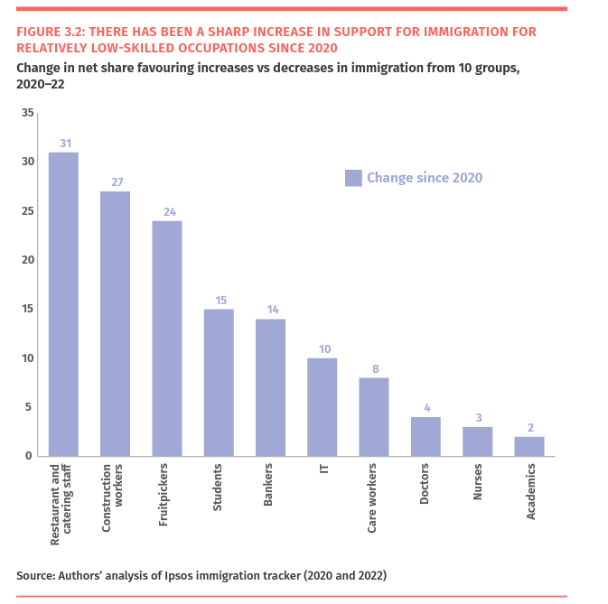
There has been a sharp shift in attitudes towards migration over the last 3 years.
From Ford and Morriss (2022): Institute for Public Policy Research

Slide 7
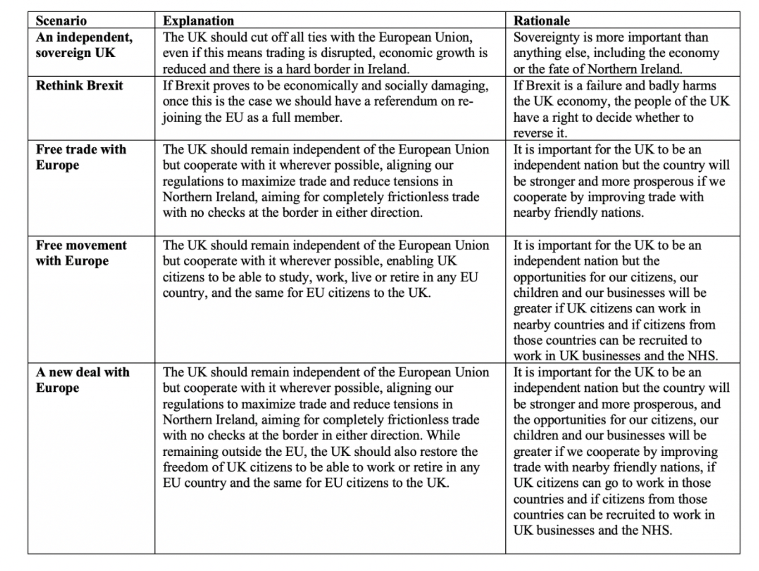
Most people would accept FoM
In two waves of my C19PRC survey (December 2021, June 2022) we asked questions about Brexit identity and attitudes towards different post-Brexit relationships with the EU.
For example, in June 2022, people were asked to consider these alternatives:

Slide 8
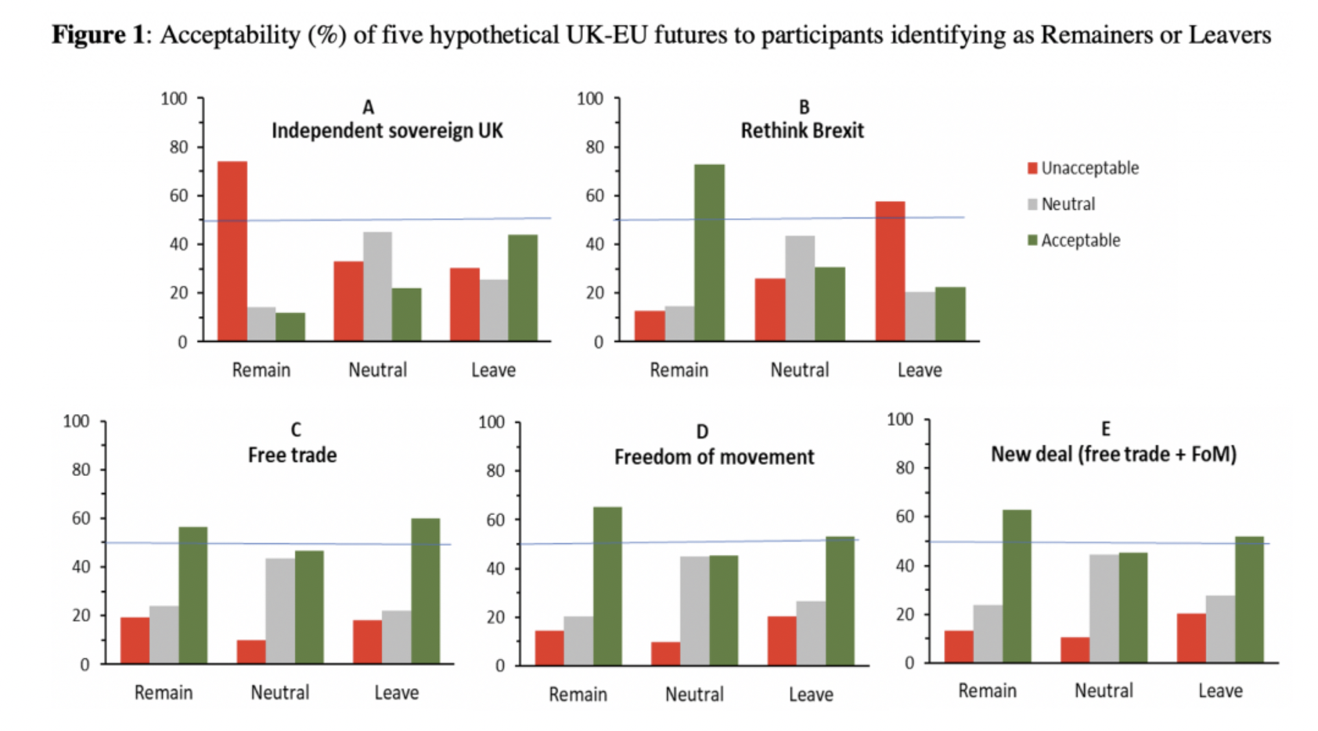
Most people would accept FoM
Freedom of movement was acceptable even amongst a majority of those who had strong leave identities.

Slide 9
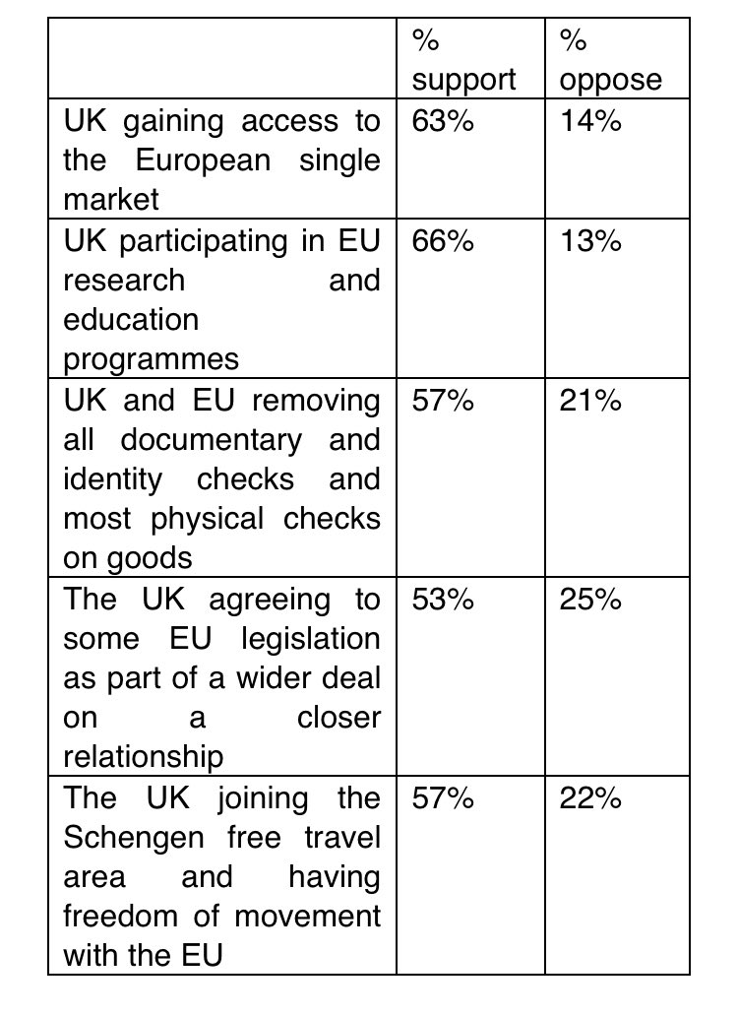
Most people would accept FoM
Opinium poll, November 30th, 2022

Slide 10
Most people would accept FoM
When asked what the SM was, 38% gave a completely correct answer, 35% gave an answer almost right, but 27% gave a wrong answer (eg. confusing it with EU membership).
55% supported joining the SM outside the EU and only 26% were opposed.
Only 12% overall and 19% of leave voters said their main concern was stopping FoM.
Loss of sovereignty was a worry for 15%; going back to old arguments for 12%.
But 21% (24% of leave voters) were concerned about paying money to Brussels!

Slide 11
Implications:
FoM should not be a ‘hard sell’
A worry: Rob Ford seems to think that changing attitudes towards migration might be a Brexit success (maybe unlikely given attitudes towards FoM).
Messaging: Obviously highlight reciprocity and benefits. We still have high migration but get nothing back.
Timing: Easier after the next election because:
Labour won’t be able to keep a lid on the issue
BUT Lib Dems could possibly put pressure on them now.
Salience:
Can FoM be linked to wider issues (eg cost of living crisis)?

Slide 12
Implications:
People are not sophisticated’
Reciprocity
Key benefits: Doctors and nurses
Borders
Segmentation? Polling in the ‘red wall’.
Opinion leaders.

